Slide 1



Thorsten Butz
The X files, Swiss Edition
09. November 2018,
Pathé Dietlikon
Notes:
geekmania.ch
thorsten-butz.de

Slide 2


Gold-Sponsor:
Silver-Sponsor:

Slide 3

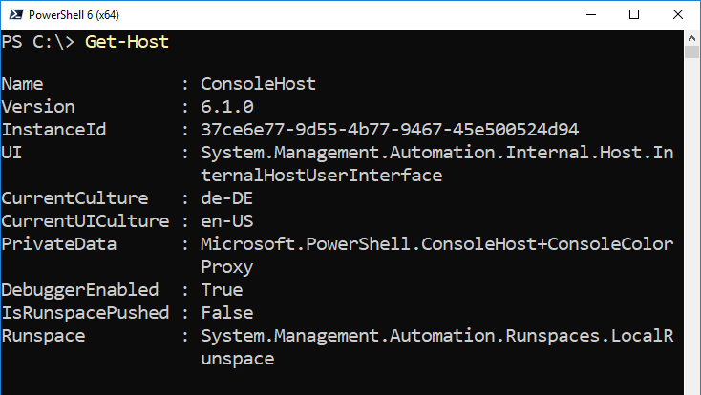
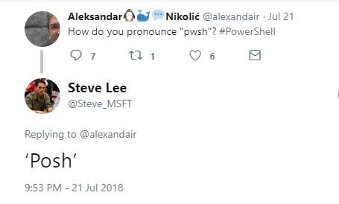
Separated at birth
Posh Spice
Posh Core
Notes:
de-DE: "Bei der Geburt getrennt"

Slide 4
Get-Content
PowerShell Core 6
$isLinux = $true
PSRP interop
Win32-OpenSSH on Windows and *nix
Implicit remoting / "rModule"

Slide 5
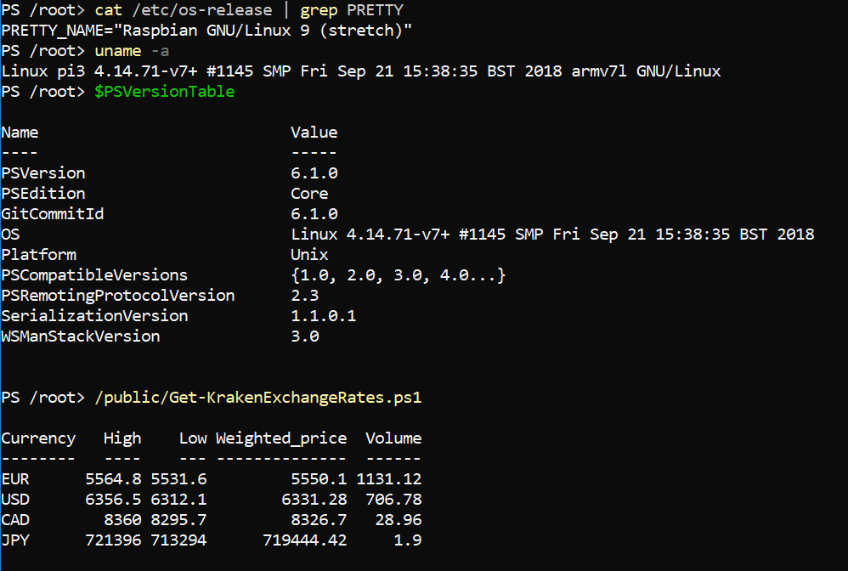
PoSh Core on RasPi
$uri = 'https://github.com/PowerShell/PowerShell/releases/download/
v6.1.0/powershell-6.1.0-linux-arm32.tar.gz'
apt-get install libunwind8
wget $uri
mkdir /opt/powershell
tar -xvf ./powershell-6.1.0-linux-arm32.tar.gz -C /opt/powershell
ln -s /opt/powershell/pwsh /usr/bin/pwsh
Notes:
# Install prerequisites
sudo apt-get install libunwind8
# Grab the latest tar.gz
wget https://github.com/PowerShell/PowerShell/releases/download/v6.1.0/powershell-6.1.0-linux-arm32.tar.gz
# Make folder to put powershell
mkdir /opt/powershell
# Unpack the tar.gz file
tar -xvf ./powershell-6.1.0-linux-arm32.tar.gz -C /opt/powershell
# Start PowerShell
/opt/powershell/pwsh
# Link pwsh
ln -s /opt/powershell/pwsh /usr/bin/pwsh

Slide 6
PoSh Core 6.1
1st version of PoSh Core: WS 2016 NANO
Support for Windows 7+
Support for LOTS of Linux distros/releases
Support for MaCOS 10.12+
Supports Unzip/Copy/Paste installations + multiple versions side-by-side
Comes with .NET Core 2.1 "attached", no sides effects on existing installations
Notes:
https://docs.microsoft.com/en-us/powershell/scripting/whats-new/what-s-new-in-powershell-core-61?view=powershell-6

Slide 7
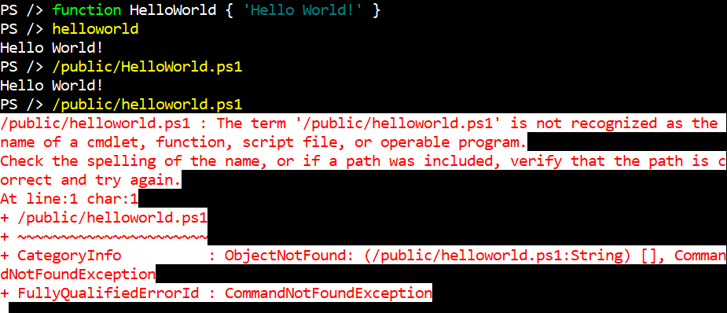
Mind the gap: Windows vs. *nix
"Same" CmdLets with different capabilites: Invoke-Command, ConvertTo-Json, ...
Less Built-In CmdLets
Missing aliases: ls, ps, wget, curl ...
NO RSAT for *nix
Case sensitivity
Notes:
Works:
$env:USERNAME
$ENV:USERNAME
Does not work:
$env:USERname
"cd" is both:
alias in PoSh
standard *nix command

Slide 8
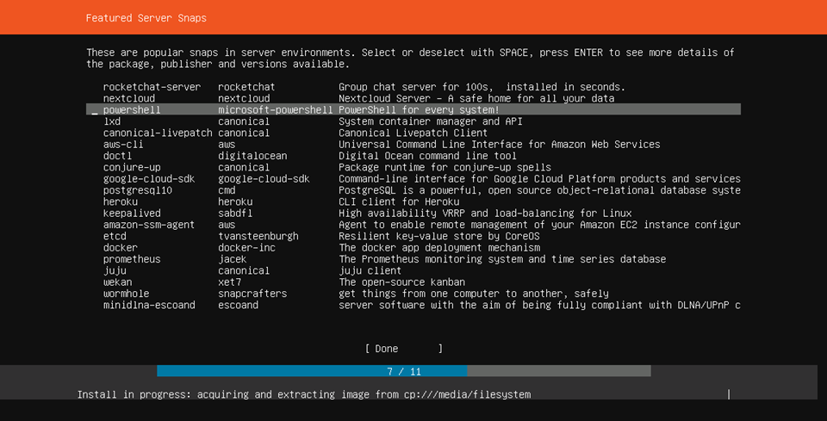
Ubuntu 18.04: Snaps

Slide 9

Demo
Notes:
http://www.publicdomainfiles.com/show_file.php?id=13932705616625

Slide 10

Demo

Slide 11
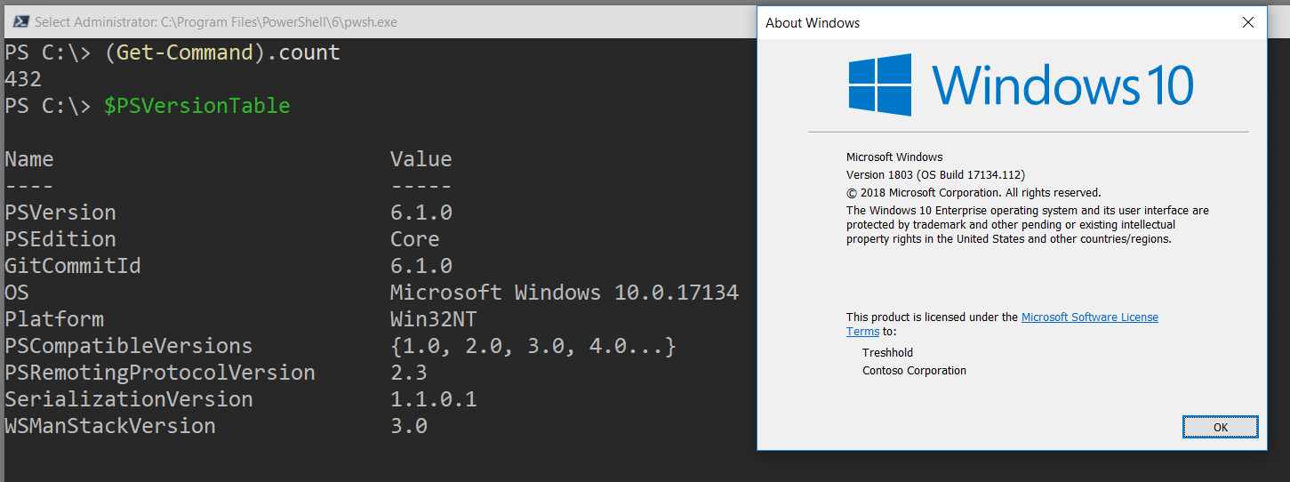
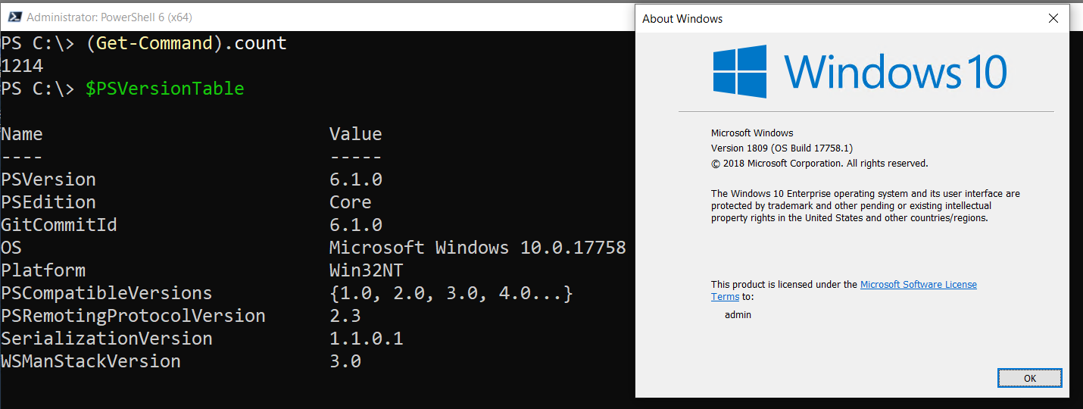
PwSh 6.1 & Windows 10

Slide 12
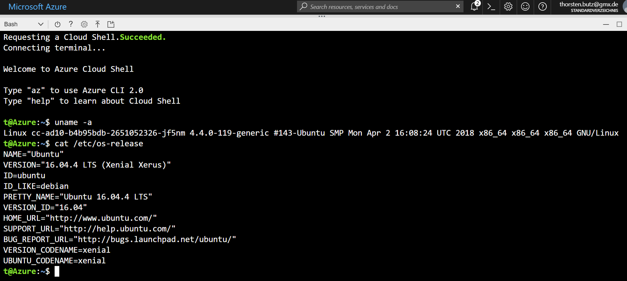
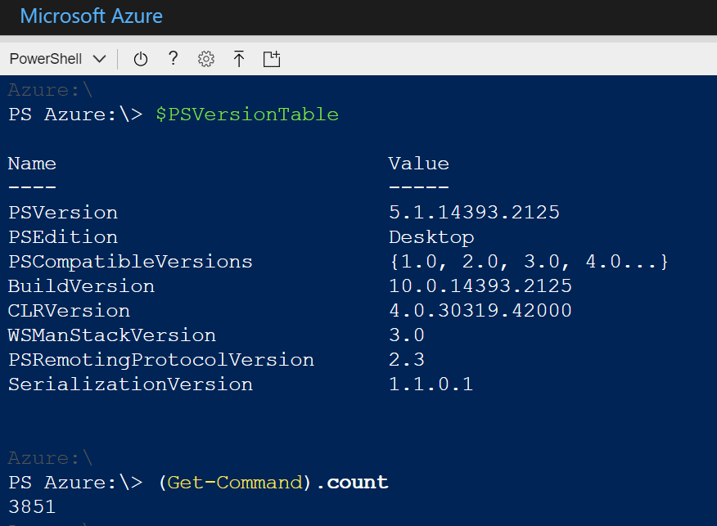
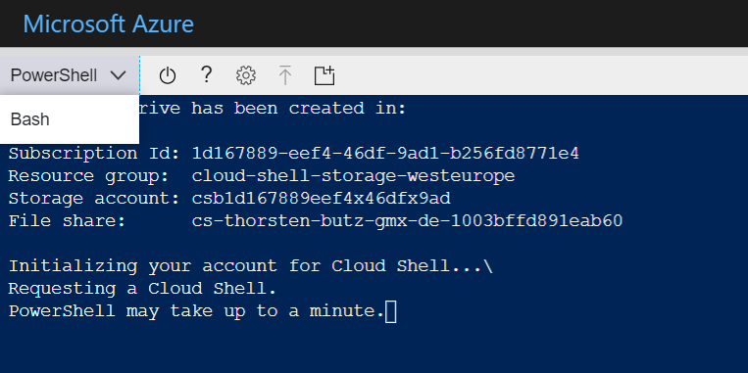
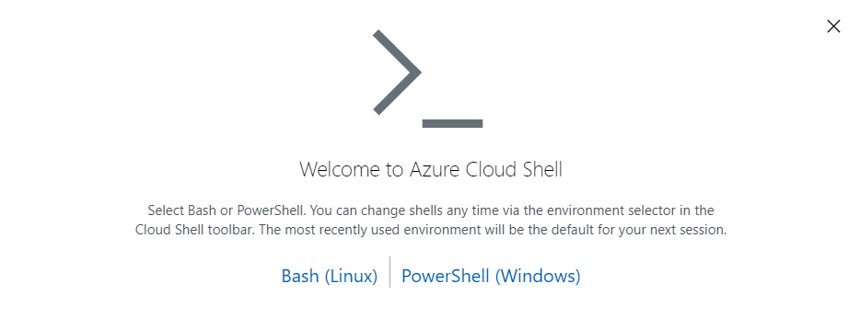
Azure Cloud Shell

Slide 13
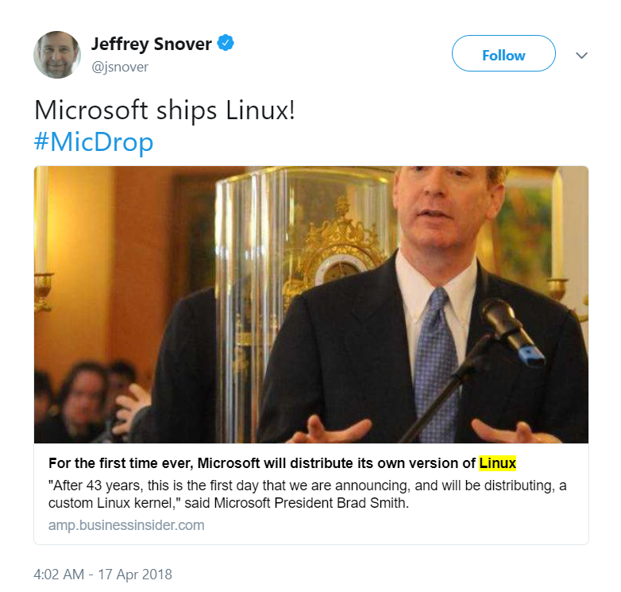
Azure Sphere (OS) for IoT devices
A new system for securing the tiny processors that power smart appliances, connected toys, and other gadgets.
Powered in large part by Linux,
Announced by Brad Smith *
* Microsoft's president and chief legal officer
Notes:
"Microsoft * announced on Monday a new technology called Azure Sphere, a new system for securing the tiny processors that power smart appliances, connected toys, and other gadgets.
Azure Sphere is powered in large part by Linux, a free operating system that Microsoft once viewed as a major threat."
Announced by Brad Smith: Microsoft's president and chief legal officer
https://amp.businessinsider.com/microsoft-azure-sphere-is-powered-by-linux-2018-4

Slide 14
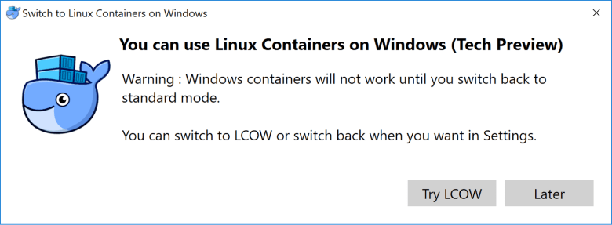
LinuxKit / LCOW
LinuxKit
A toolkit for building custom minimal, immutable Linux distributions
< 40 MB
LCOW
LinuxKit images and utilities for Microsoft's Linux Containers on Windows.
Requires Hyper-V Containers https://github.com/linuxkit/lcow
Notes:
https://stefanscherer.github.io/sneak-peek-at-lcow/
https://blog.docker.com/2017/11/docker-for-windows-17-11/
https://blog.docker.com/2017/12/top-5-blogs-2017-linuxkit-toolkit-building-secure-lean-portable-linux-subsystems/

Slide 15
Wrap up!
PoSh + Win32_OpenSSH
partially BETA quality
rapid deployment
community driven
$isConfusing = $true
Notes:
Joey Aiello about PowerShell 6
"I really dont see it as Microsoft's product anymore, this is very much a community OpenSoure project
that all of us are working on. "
May MeetUp with Joey Aiello: PowerShell 6 and OpenSSH (Mai 2017)
https://www.youtube.com/watch?v=Pa3P6gFEc6I

Slide 16
Questions?

Slide 17


Podcast: Sliding Windows
www.slidingwindows.de/?feed=slw-mp3
Get-Guest
Jeffrey Snover
Bruce Payette
Bartek Bielawski, Joey Aiello
Rolf Masuch
(..)

Slide 18
Gold-Sponsor:
Silver-Sponsor:

Slide 19
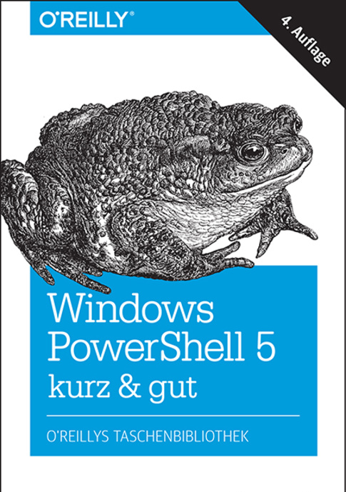
about_Speaker
Thorsten Butz thorsten-butz.de @thorstenbutz

Slide 20
Get-Content | more
What's new in PowerShell - BRK3069 https://youtu.be/9fFAND6OCKU
What's New in PowerShell Core 6.1 https://docs.microsoft.com/en-us/powershell/scripting/whats-new/what-s-new-in-powershell-core-61
PowerShell unplugged with Jeffrey Snover and Jason Helmick - BRK2051 https://youtu.be/DPICqEiz3m4

